Slide 1
IT 304 Computer Networks Autumn 2022
Week 2-Lecture 1
8/8/2022

Slide 2
Recap: Network components
Network has three main components
Computers (servers and hosts)
Hosts/End systems: hosts files, webpages, other resources
Clients: ask for the resrouces
Servers: give the requested resources
Network Devices
- Devices that interconnect different computers together
Connectivity
- Media that physically connect the computers and network devices

Slide 3




















What’s the Internet: “nuts and bolts” view
PC
billions of connected computing devices:
hosts = end systems
running network apps-Meaning?
mobile network
server
wireless
laptop
global ISP
smartphone
home
network
communication links
fiber, copper, radio, satellite
transmission rate: bandwidth
regional ISP
wireless
links
wired
links
packet switches: forward packets (chunks of data)
routers and switches
router
institutional
network
Notes:
3

Slide 4
What’s the Internet: a service view
mobile network
infrastructure that provides services to applications:
Web, VoIP, email, games, e-commerce, social nets, …
provides programming interface to apps
hooks that allow sending and receiving app programs to “connect” to Internet
provides service options, analogous to postal service
global ISP
home
network
regional ISP
institutional
network

Slide 5
What is a computer network?
A set of network elements connected together, that implement a set of
protocols for the purpose of sharing resources at the end hosts
•
Three important components:
•
Core infrastructure:
• A set of network elements connected together
Protocols:
• Needed to use the network
Purpose:
Sharing resources at the end hosts (computing devices)
•
•

Slide 6
What do computer networks do?
A computer network delivers data between the end points/hosts
•
One and only one task: Delivering the data
•
This delivery is done by:
•
•
Chopping the data into packets
Sending individual packets across the network
• Reconstructing the data at the end points
Evolution of three components of computer networks!
• Infrastructure, protocols, purpose

Slide 7
Data delivery as a fundamental goal
•
Support the logical equivalence of Interprocess Communication (IPC)
• Mechanism for “processes on the same host” to exchange messages
•
Computer networks allow “processes on two different hosts” to
exchange messages
•
Clean separation of concerns – Division of roles
• Computer networks deliver data
• Applications running on end hosts decide what to do with the data
•
Keeps networks simple, general and application-independent

Slide 8
1. A network consists of
A. End hosts
B. Network core devices
C. Links
D. All of the above
E. None of the above
3. The Internet provides
A. Best effort service
B. Guaranteed service
2. Is there a difference between host and an end system?
A. Yes
B. No

Slide 9
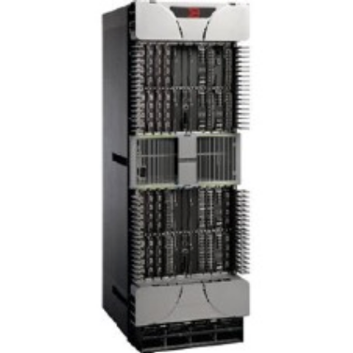

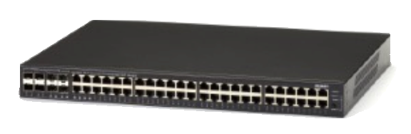
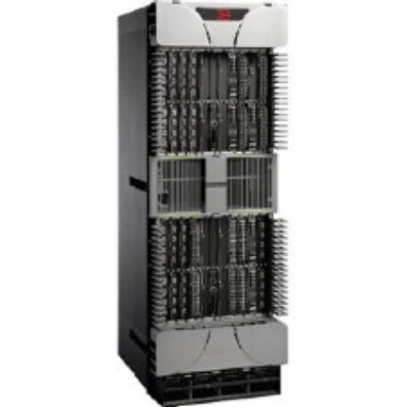

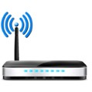
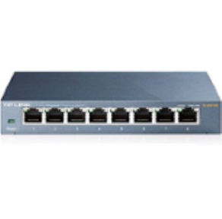

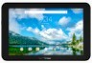


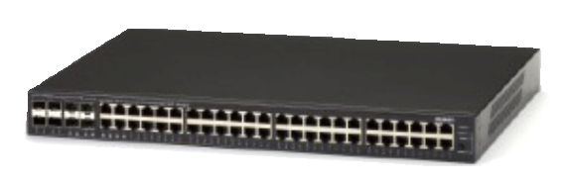
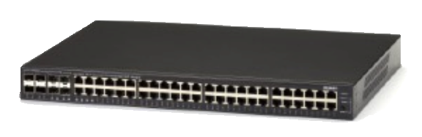
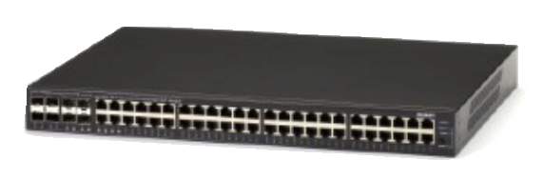


What do computer networks look like?
End hosts, switches/routers, links

Slide 10
Chapter 1: roadmap
1.1 what is the Internet?
1.2 network edge
end systems, access networks, links
1.3 network core
packet switching, circuit switching, network structure
1.4 delay, loss, throughput in networks
1.5 protocol layers, service models
1.6 networks under attack: security
1.7 history
Notes:
10

Slide 11









A closer look at network structure:
network edge:
hosts: clients and servers
servers often in data centers
mobile network
global ISP
access networks, physical media: wired, wireless communication links
home
network
regional ISP
network core:
interconnected routers
network of networks
institutional
network

Slide 12



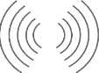



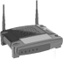

The network core
mesh of interconnected routers
packet-switching: hosts break application messages into packets
forward packets from one router to the next, across links on path from source to destination
each packet transmitted at full link capacity

Slide 13
Architectural principles, design goals and performance objectives in wired
networks
•
What tasks get done?
• What is delivered (packets, files, …)?
• What are the semantics (reliability, ordering, …)?
•
Where do tasks get done?
• At the network elements? At the end-hosts?
•
How do end hosts interface with network elements?
• How do different network elements interface with each other?
•
How tasks get done?
• What protocols and algorithms do each of these use?
• How to achieve various performance objectives (latency, etc.)?

Slide 14
Many mechanisms: What do we mean by …
Locating a destination? →Naming, Addressing
Finding path to the destination → Routing
Sending data to the destination → Forwarding
Failures, reliability,etc..→ Congestion control

Slide 15
What are the performance metrics?

Slide 16
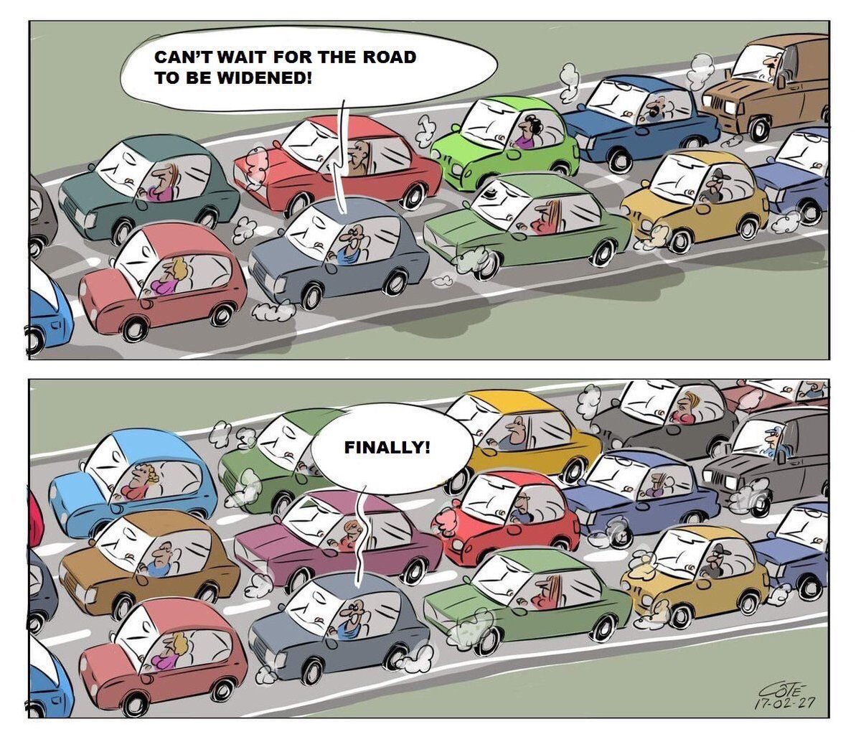
Capacity
How wide is the road?
How fat is the tunnel?
How many cars can fit at a time?
One, two, three…?

Slide 17
Performance metrics in computer networks!
Capacity is Bandwidth: Number of bits sent per unit time (bits per second, or bps)
• Depends on
• Hardware
• Network traffic conditions
Ref [1]
Ref [1]: https://www.elandcables.com/the-cable-lab/faqs/faq-what-is-bandwidth-in-cables

Slide 18
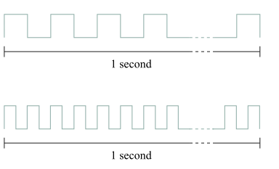
Each bit is a pulse of some width.
For example, each bit on a
1-Mbps link is 1 µs wide
2-Mbps link is 0.5 µs wide,
The narrower each bit can become, the higher the bandwidth.
This means more bits can get inside the tunnel
So MORE DATA CAN FLOW WITHIN A TIME

Slide 19
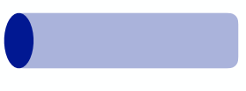
Time taken is Propagation delay: Time for one bit to move through the link (seconds)
• Depends on
Hardware
Distance between machines
Propagation
Delay

Slide 20
Bandwidth-delay product (BDP)
Number of bits “in flight” at any point of time (bits)
• Bits sent, but not received
Bandwidth
Bandwidth x delay
Propagation
Delay
•
Same city over a slow link
•
Bandwidth: ~100Mbps
• propagation delay: ~0.1ms
• BDP = 10,000 bits (1.25KBytes) Between cities over fast link:
• Bandwidth: ~10Gbps
•
•
propagation delay: ~10ms
• BDP = 100,000,000 bits (12.5MBytes)

Slide 21
Access network means
A. The communication links
B. The routers and switches
C. A
D. B
E. Neither of them
Bandwidth is
A. The number of bits sent per unit time
B. Size of the data generated
Traffic conditions impact both bandwidth and delay
A. True
B. False

Slide 22
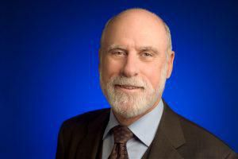
Google celebrates its birthday on September 27, although no one really knows the exact date when it was founded. Started by two Stanford college friends, Larry Page and Sergey Brin, in 1998, it is a multi-billion dollar enterprise now. The name comes from a simple misunderstanding when they were searching for another, actual, word that existed in academia and meant a particular number. What word is that and what number does it denote?
Googol, 1 followed by 100 zeros
Gmail was launched by Google on April 1, 2004, which led many to believe it was an April Fool’s joke. Before this service the term ‘G-mail’ already existed from as early as 1998. This was used online by fans of a certain fictional obese cat, and the original G-mail was known as “e-mail with cattitude”. What does the G stand for in the original G-mail?
Garfield
When Page and Brin built the first server rack for Google at Stanford, they were looking for a cabinet to house it that was easy to assemble and disassemble. The server contained ten 4GB hard disks and two cooling fans. What colourful and bountifully found system did they use to build the server stack?
Lego bricks
Who is the father of the Internet?
Vincent Cerf

Slide 23
Why study computer networks?
#1: Has transformed and more importantly, is transforming everything!
•
Industry: core to and creator of many large and influential companies
• Google, Facebook, Apple, Cisco, Juniper, Akamai
Communication
•
•
Email, messenger, phones, VoIP, …
•
Travel
• AirBnB, Uber, Maps, …
Health
• Digital health, remote diagnostics, ….
Entertainment
•
•
•
Netflix, Prime
•
Relationships
• Facebook, Instagram, Snapchat, the list is endless…

Slide 24
Why study computer networks?
#2: To learn how to design for scale!
•
Tremendous scale
•
•
•
51% of world population
1.24 trillion unique web pages Every second, approximately
•
•
•
> 2 million emails
> 40000 Google search queries
> 6000 Tweets
• Introduced the phrase “Internet Scale”

Slide 25
Why study computer networks?
#3: To learn how to design for diversity!
•
•
•
•
•
•
•
Communication latency: Microseconds to seconds
Bandwidth: 1Kilobits/second to 100Gigabits/second
Packet Loss: 0-90%
Technology: Wireless, satellite, optical, copper, …
End hosts: Sensors, cell phones, computers, servers, datacenters, …
Applications: www, voice, video, gaming, remote medicine
Trust models: selfish (users), malicious (attackers), greedy (companies), …
And yet, everything needs to work in tandem!

Slide 26
Recap: Packet switching summary
•
Goods:
•
•
Easier to handle failures
No resource underutilization
• A source can send more if others don’t use resources No blocked connection problem
No per-connection state
No set-up cost
•
•
•
•
Not-so-goods:
•
•
Unpredictable performance
High latency
• Packet header overhead

Slide 27
Recap: Deep dive into one link: packet delay/latency
•
Consists of six components
•
Link properties:
• Transmission delay
• Propagation delay OS internals:
• Processing delay
• Queueing delay
Traffic matrix and switch internals:
• Processing delay
• Queueing delay
•
•
•
•
First, consider transmission, propagation delays
Queueing delay and processing delays later in the course

